Slide 1

Hand Gesture to Text Converter (DivyaAnuvadak) BTI_G05
© Templateswise.com
Department of Computer Science
Submitted By :
Ayushi Rajput – 2016730
Deepali – 2016736
Shivalik – 2016821
Sneha Poddar – 2016837

Slide 2

Content
INTRODUCTION
Purpose
Scope
OVERALL DESCRIPTION
Product Perspective
Product Function
Hardware and Software Interfaces
User Characteristics and Constraints
Technologies Used
SPECIFIC REQUIREMENT
Functional Requirements
Non-Functional Requirements
SYSTEM ARCHITECTURAL DESIGN
High Level Design
Detailed Description of Product
Structure Chart
Data Flow Diagram
Flow Chart
Use Case Diagram
Sequence Diagram
Activity Diagram
USER INTERFACE DESIGN
Description of User Interface
Screen Image
Objects and actions
TEST
Unit Test
System Test
Integration or Regression Test
Stress Test
Acceptance and Staging
REFERENCE

Slide 3

Introduction
Purpose
The main problem that the project aims to solve is to reduce the communication gap of speech or hearing impaired people with the normal ones.
DivyaAnuvadak is a web application that converts ISL to text.
The aim of this presentation is to specify the features, requirements of the final product and the interface of ISL recognition

Slide 4
Scope
It will facilitate speech and hearing impaired people to ease their communication.
It can be used in offices, institutions or seminars.
It would help both our community and university to build a startup and educate these specially-abled people.

Slide 5
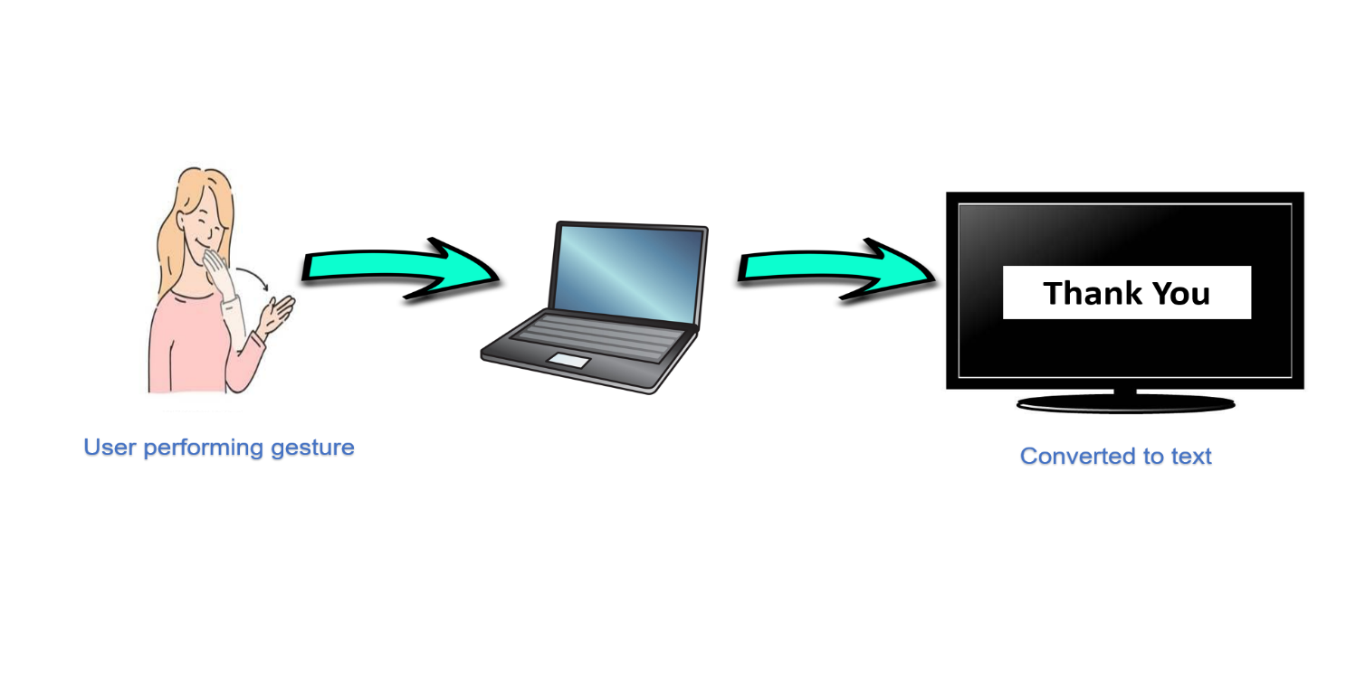
Overall Description
Product Perspective
DivyaAnuvadak will serve the speech and hearing impaired people by providing their gestures converted to the equivalent text.
This system will consist of one web portal. This web portal will be used for converting gestures into its corresponding text. The predefined gestures will be stored in the memory and will be compared with the original gesture performed by the user.

Slide 6
Product Function
Capture the gestures made by the user through a web camera.
Recognizing the gestures through Tensorflow Object Detection API by identifying features.
Pre-Processing the captured data.
Feeding the data to the model.
Predicting the word based on processed model.
Selecting the word of highest possibility.
Converting the word into text and displaying it on the screen.

Slide 7
Hardware Interface
Software Interface
SERVER SIDE:
RAM : 8 GB (minimum)
HDD : 1 TB or more
Processor : Intel® i3 or faster (2–4 GHz)
GPU : 2 GHz or more
CLIENT SIDE:
RAM : 8 GB (minimum)
HDD : 512 GB or more
Processor : Intel® Pentium or faster (2-4 GHz)
Camera : 720 Pixels or more
SERVER SIDE:
Operating System : Windows 10 or 11
Web Server : Apache Tomcat (v10)
IDE : Jupyter Notebook (v6.4.8), VS Code (v1.74.3)
Programming Language : Python
CLIENT SIDE:
Operating System : Windows 7 or higher versions
Web Browser : Any Browser
Library : Streamlit

Slide 8
User Characteristics
User is required to have basic knowledge of computing and internet surfing.
User should have good knowledge of ISL and English.
Constraints
Hardware limitation on mobile devices.
Full-fledged translation is not possible.
Only one-way communication is possible.
Fast-paced communications are not possible.

Slide 9
Technologies Used
Python
Jupyter Notebook
Tensorflow
Streamlit
Open CV

Slide 10
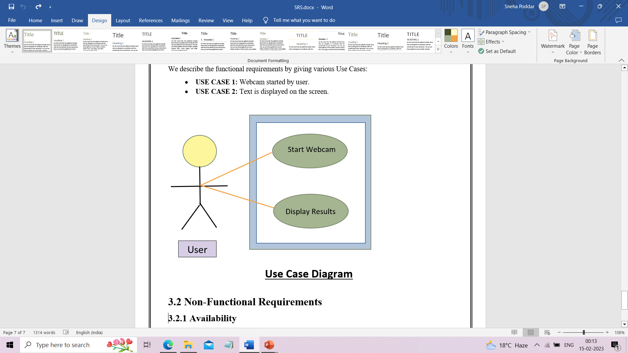
Specific Requirements
Functional Requirements
Use case Name | Sign Language Recognition
Participating actors | User
Flow of events | Start the system(u) Capturing video(s) Capture gestures(s) Extract features(s) Match features(s) Recognizing gestures(s) Display result
Entry condition | Run the code
Exit condition | Displaying the text label
Quality requirements | Cam pixels clarity, good light condition
Use Case Diagram

Slide 11
Non-Functional Requirements
Availability
This web application will be available free on the internet. The users do not require to login so it is user friendly.
Security
This web application does not ask for any personal information from the user. Hence it is a secure application.
Reliability
The application will be 99% reliable and will produce correct speech for the corresponding gestures.
Portability
This project is a web application so it will be available online and can be accessed from any device having internet connectivity, e.g.: laptops, computers, mobile devices etc.

Slide 12
System Architectural Design
High – Level Design
Raw data
Raw data
Pre-processing
Pre-processing
Training Phase
Testing Phase
Feature Engineering
Feature Engineering
Features
Features
Model Training
Model
Predictions

Slide 13
Detailed description of components
Structure Chart
Main
Gesture Window
Text Window
Verified
Display
Display text

Slide 14
0-Level DFD
Database
Admin
User
Train
View Home Page
Update dataset
DivyaAnuvadak

Slide 15
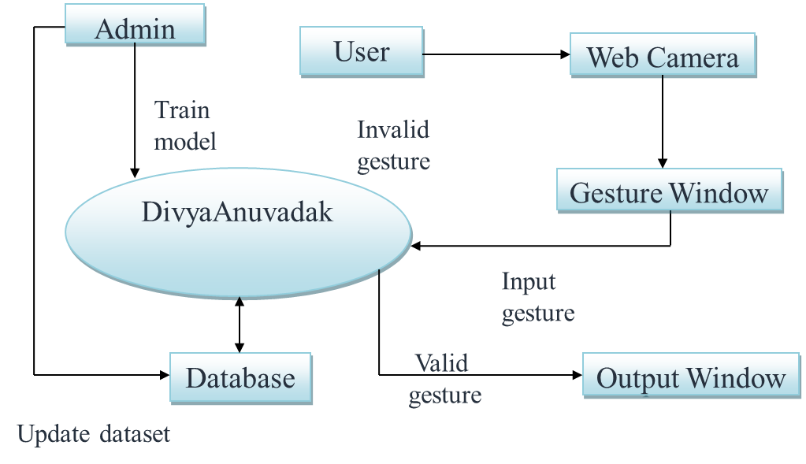
1-Level DFD

Slide 16
Backend Flowchart
Start
Dataset collection
Hand region segmentation
Train Model
Test Model
End

Slide 17
Testing
Start
Input
Gesture Segmentation
Model
End

Slide 18
Frontend Flowchart
Start
Hand image input from web camera
Hand Gestures Recognition
Text Output
End

Slide 19
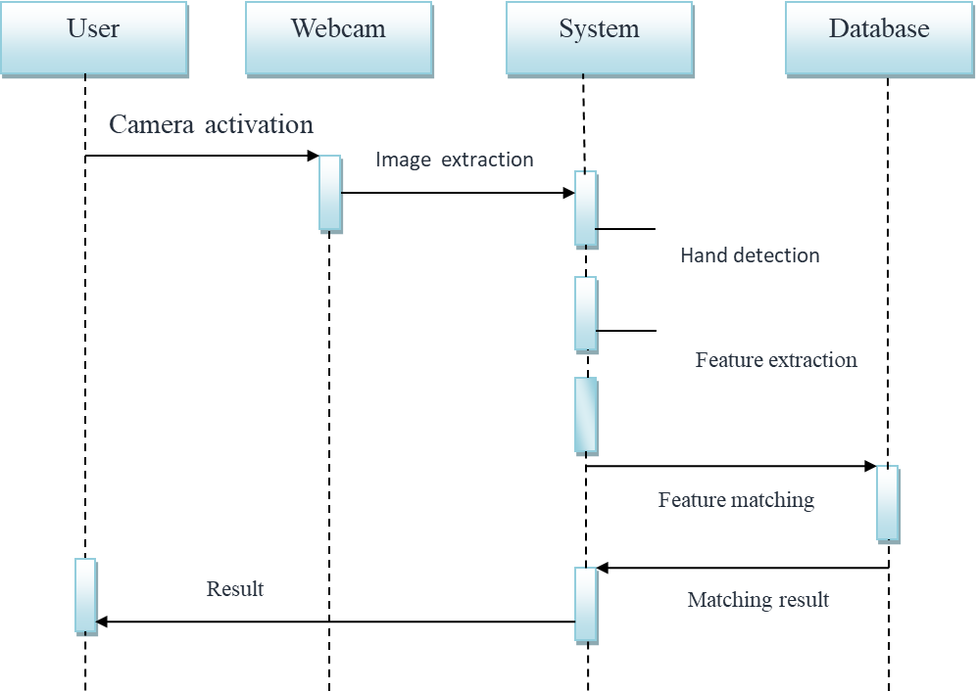
Sequence Diagram

Slide 20
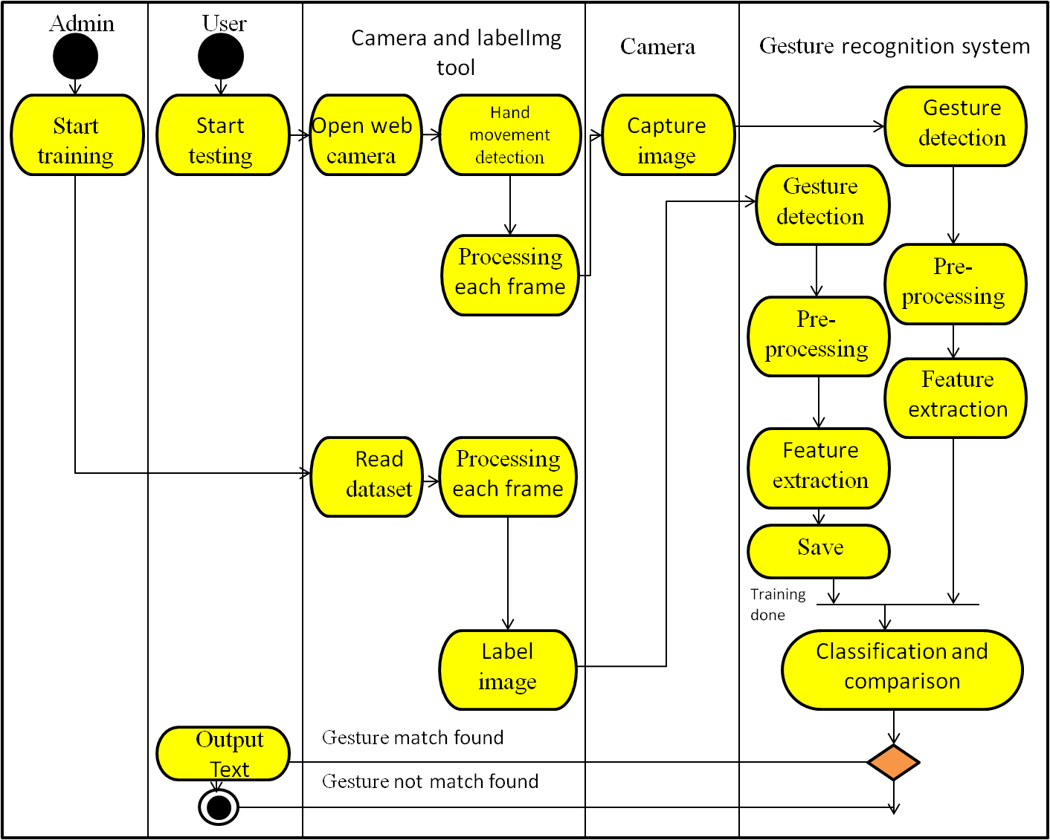
Activity diagram

Slide 21
User Interface Design
Description of the user interface
Input – Hand Gesture
Output – Corresponding Text.
Processing Details
The hand gestures given by the user through web-camera will be processed.
Then it will be checked whether the input is valid or not.
Eventually, the system would generate the corresponding output text in the text window.

Slide 22
Description of Component
Gesture Window
In this window, user would provide hand gesture as input which would be further verified and processed by the system.
Text Window
In this window, corresponding text will be displayed with respect to the valid hand gestures.

Slide 23
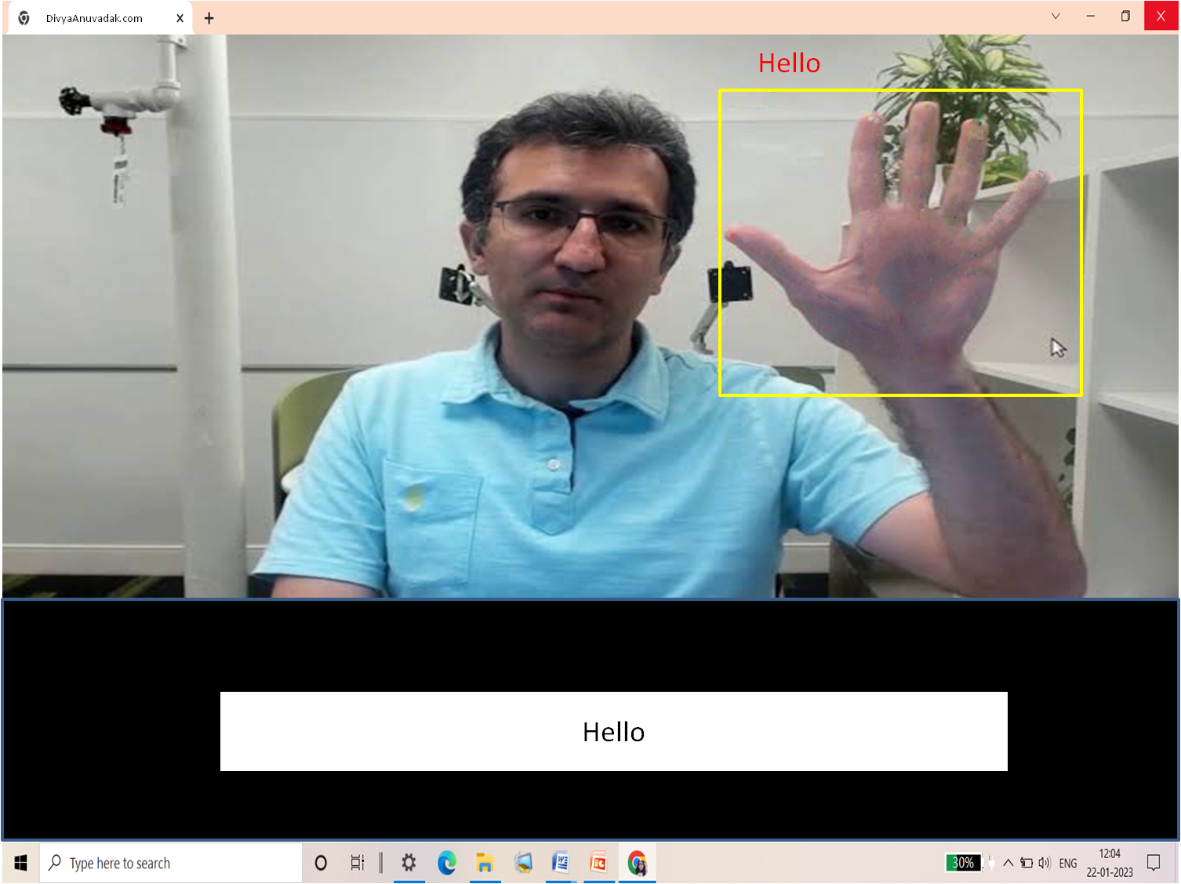
Screen Image

Slide 24
Objects and Actions
Object – Textbox
Purpose – To convert hand gestures into text
Action – Gesture
Response – Corresponding text output of gesture

Slide 25
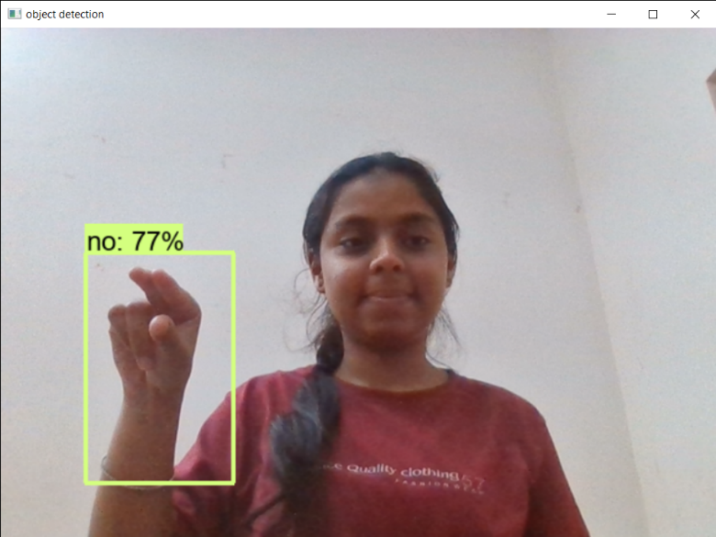
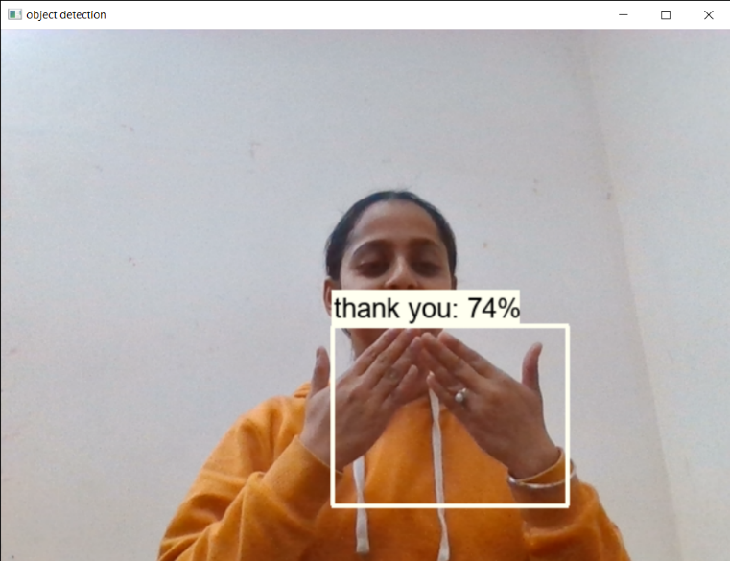
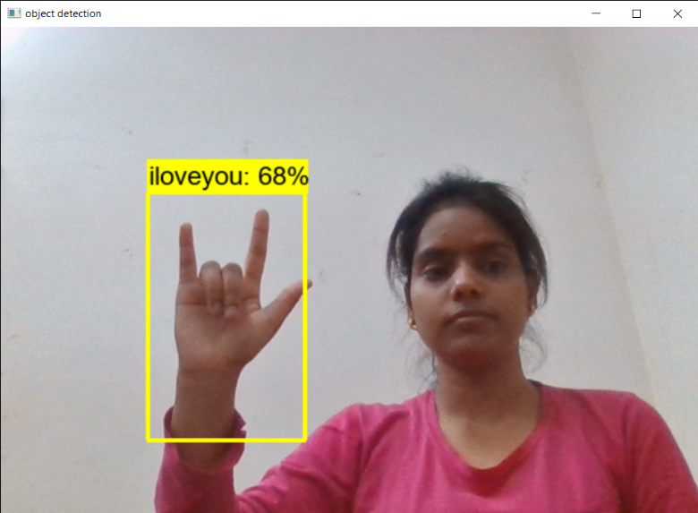
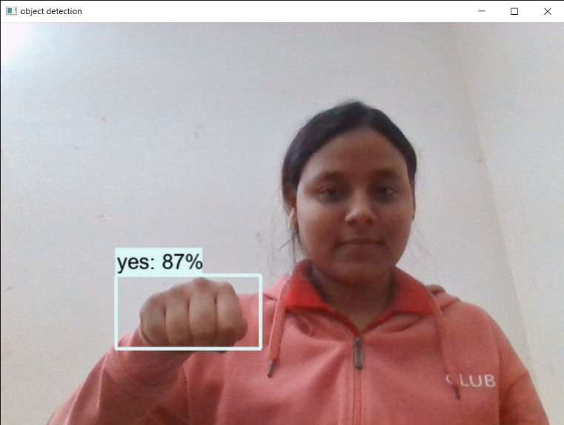

Slide 26
Types of Tests
Unit Tests: This test is applied on each of the module to find whether or not each module is properly working or not.
System Tests: Black box testing or system testing involves the external working of the software opposite to white box testing which checks for the internal working or code of a software application.
Integration or Regression Tests: After unit test integration testing is done to test if the entire system works together correctly. While regression testing tries to ensure that a newly added feature or modified code does not break any functionality already working in the existing system.
Stress Tests: Here we provide our software with some unfavorable conditions to check how they perform in such conditions.
Acceptance Tests and Staging: This test will ensure that the quality of the product is not compromised.

Slide 27
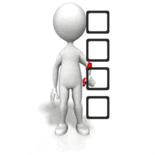
References
https://docs.streamlit.io/
"A Concise Introduction to Software Engineering" by Pankaj Jalota
Pressman Roger S., "Software Engineering - A Practitioner’s Approach" Fifth Edition,
McGraw-Hill Publication, 2000
IEEE STD 830-1998, IEEE Recommended Practice for Software Requirement
Specifications
https://ieeexplore.ieee.org/document/720574

Slide 28


